Slide 1
Heritage High School Making the most out of High School
JUNIORS!
November 7th, 2019

Slide 2
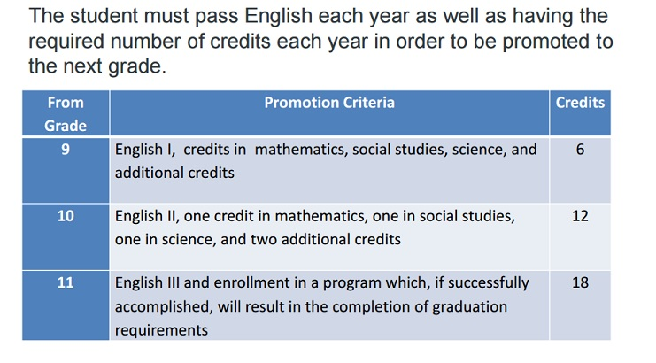
Academics
Where do you stand academically? Current GPA?
Does my current performance match my post-secondary goals?
How many credits have you earned? 26 to graduate!
Notes:
TT

Slide 3
Senior Year Course Selections
It is important to continue to challenge yourself academically your senior year.
Colleges will see your senior schedule

Slide 4
Post-Secondary Planning
Dual Enrollment Opportunities
Now is the time for exploring all of your interests and doing research on where you want to go after high school.
Notes:
TT

Slide 5
ccp.waketech.edu
http://hhsacademics.weebly.com/dual-enrollment.html
Notes:
LW to introduce M. Lair

Slide 6
Internships and Teacher Cadets

Slide 7
Teacher Cadet

Slide 8
College Research
Consistent email account that you check regularly for colleges
College Admission Representatives
Create accounts forCFNC.org! collegeboard.org!
College Fairs – in person and virtual
Notes:
TT

Slide 9
Academics SAT and ACT
ACT in Spring 2020 for FREE
Sending your scores (collegeboard.org, actstudent.org)
Notes:
LW:
The ACT measures achievement related to high school curricula, while the SAT measures general verbal and quantitative reasoning.
Many colleges use the Subject Tests for admission, for course placement, and to advise students about course selection. Used in combination with other background information (your high school record, scores from other tests like the SAT Reasoning Test, teacher recommendations, etc.), they provide a dependable measure of your academic achievement and are a good predictor of future performance. Some colleges specify the Subject Tests they require for admission or placement; others allow applicants to choose which tests to take. All Subject Tests are one-hour, multiple-choice tests

Slide 10
Academics UNC System Minimum Admissions Requirements
 | Minimum HS GPA | Minimum SAT (CR+M) | Minimum ACT (Composite Score)
Fall 2013 and Beyond | 2.5 weighted | 1010 | 19
The UNC System includes 17 colleges and universities in NC.
Notes:
LW

Slide 11
Extra Curricular Opportunities Get involved!
School based extracurricular activities- clubs, athletics, fine arts, honor societies
Considering college athletics? Visit ncaaeligibiltycenter.org
Outside of School activities- community service, employment, outside organizations
Quality v. Quantity
Leadership
Are you a mover and a shaker?
Notes:
LW
matching activities to goals- i.e. science clubs/activities for Gov School and NCSSM, Engineering prgms, etc.
Extracurricular Activities
*School Extracurricular Activities
*Outside of School – community service, employment, outside organizations
*Leadership: Quality v. Quantity
Extra Opportunities
*School year – NCSSM-10th grade
*Summer programs – Governor’s School, HOBY-10th, Summer Ventures in Science and Math
*Check this link for more summer opportunities: http://heritagehs-student-services.weebly.com/summer-opportunities.html

